Slide 1

Data Vault 2.0
Juan Fernando Sánchez Martínez

Slide 2
Overview
1
Evolución de Data Warehousing
2
Data Vault 2.0
3
Modelado en Data Vault 2.0
4
Arquitectura de Data Vault 2.0
5
Conclusiones

Slide 3
Overview
1
Evolución de Data Warehousing
2
Data Vault 2.0
3
Modelado en Data Vault 2.0
4
Arquitectura de Data Vault 2.0
5
Conclusiones

Slide 4



Evolución de metodologías de modelado de Data Warehouse
Bill Inmon
1992
Kimball
1996
Linstedt
1999-2013
Definición EDW
Modelo normalizado (3NF)
Enfoque Up-to down
3-layer architecture
Se adapta a necesidades inmediatas del negocio
Modelo Dimensional (Star Schema)
Enfoque Bottom-up
2-layer architecture
Data Vault
Refined 3-layer architecture
Diseñado para superar las limitaciones de los enfoques anteriores

Slide 5
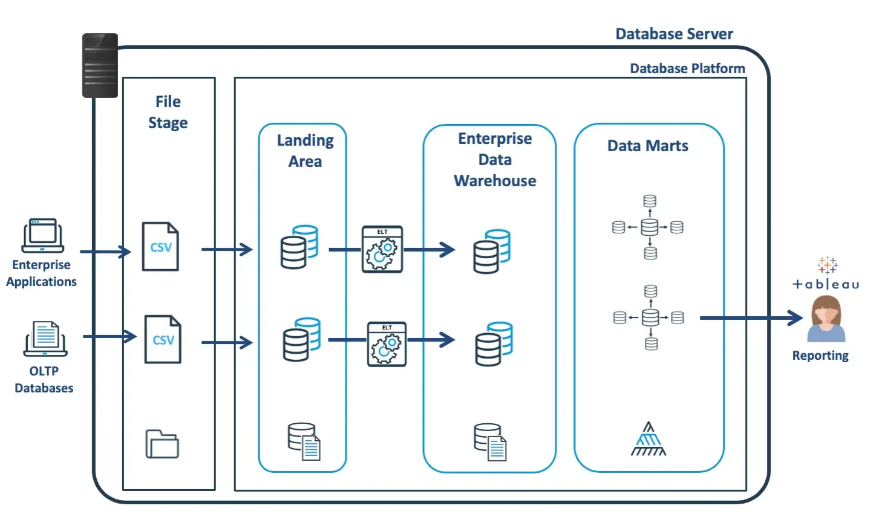

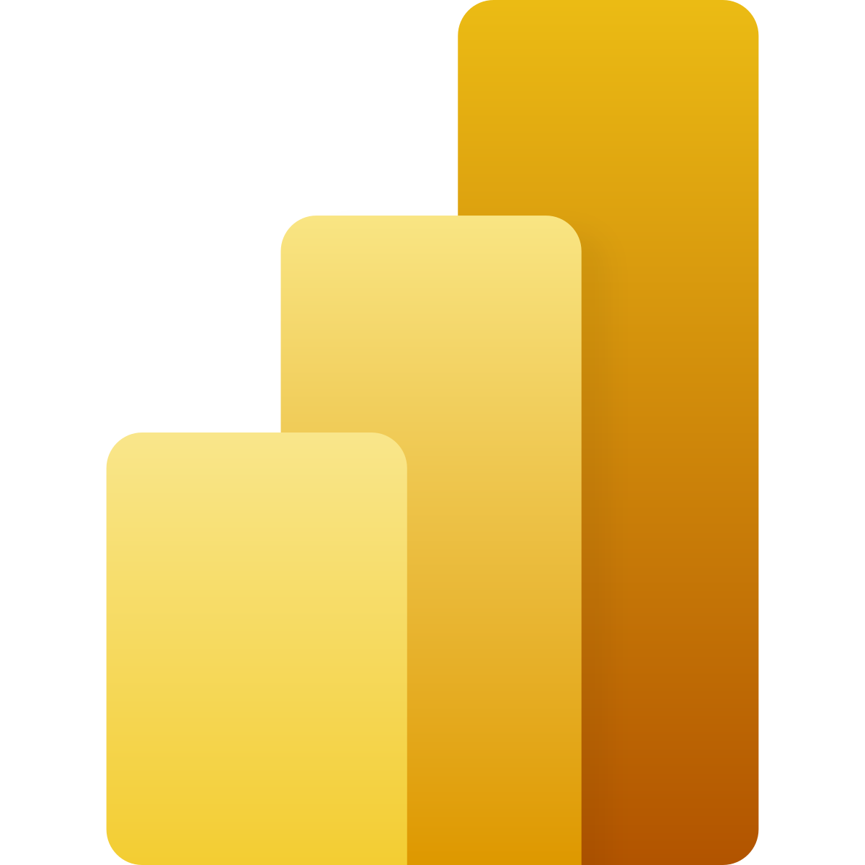

Metodología Inmoll
Stage
EDW
Data Access
Single source of truth.
Less prone to errors.
Completeness
Initial set-up and maintenance cost
Skills needed
More ETL is needed
Fuente: John Ryan (2020) Data Vault — An Overview
Notes:
Advantages of Inmon’s architecture
Flexibility. Inmon’s approach is much more flexible to changing business requirements and more flexible to modifications to the data sources. Because of the ETL process design that leads to normalized data, Inmon’s architecture is more adaptable. The architects change just a couple of normalized tables, and the change is propagated downstream.
Single source of truth. Because of the normalized data model, the data warehouse acts as a single source of truth throughout the enterprise.
Less prone to errors. Normalization avoids data redundancy so both the engineering processes and analytic processes are less prone to errors.
Completeness. Inmon's approach covers all the Enterprise data, so all the reporting needs are covered.
Disadvantages of Inmon’s architecture
Initial set-up and maintenance cost. Setting up and maintaining Inmon’s architecture is much more expensive than the time and investment needed for Kimball’s architecture. Normalized schemas exhibit greater complexity both in design and maintenance than their denormalized counterparts.
Skills needed. Inmon’s approach necessitates highly skilled engineers, which are harder to find and more expensive to keep on the payroll.
More ETL is needed. By separating data marts from the data warehouse, more ETL processes are needed to construct the data marts, therefore leading to more engineering overhead.

Slide 6
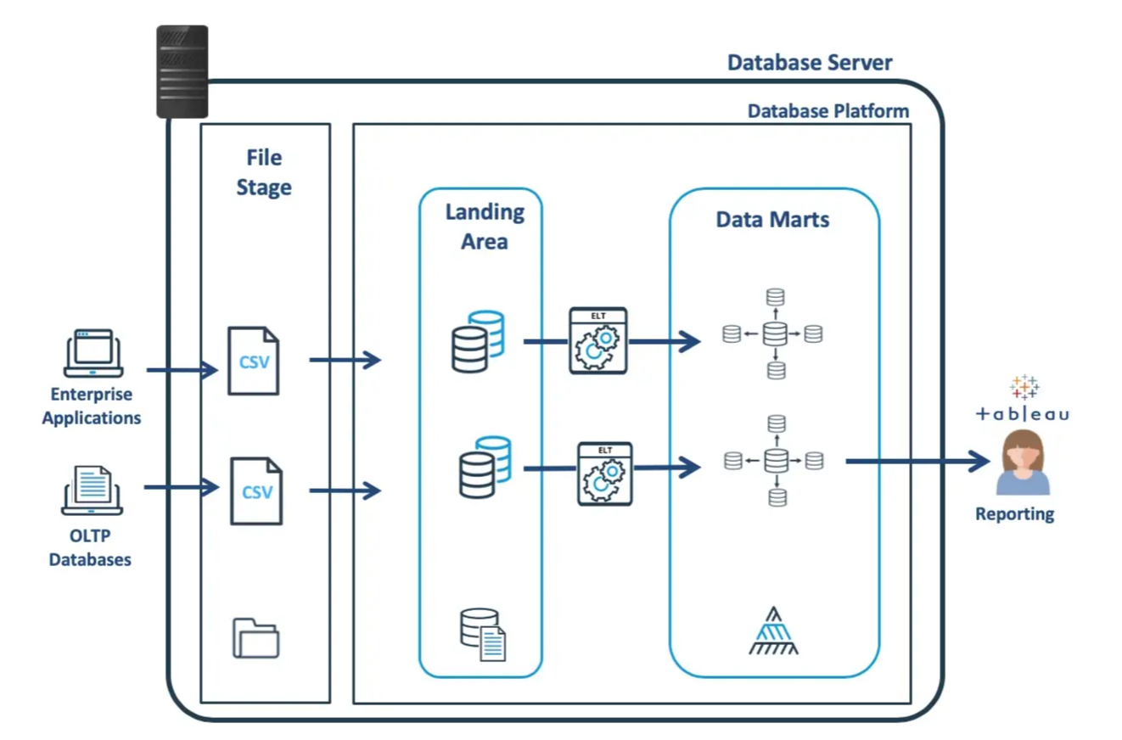

Metodología Kimball
Stage
Data Access
Simplicity and speed
Understandable
Relevancy
Data redundancy
No single source of truth
Less flexible
Incomplete
Fuente: John Ryan (2020) Data Vault — An Overview
Notes:
Advantages of Kimball’s architecture
Simplicity and speed. Kimball’s architecture is much simpler and faster to design and set up.
Understandable. The dimensional data model is easy to understand for non-technical and technical employees alike.
Relevancy. Unlike Inmon’s architecture, Kimball’s bottom-up approach makes all data integrations relevant to the business needs.
Engineering team needs. Kimball’s approach needs fewer engineers with less specialized technical skills to both set up and maintain the data warehouse than Inmon's approach.
Disadvantages of Kimball’s architecture
Data redundancy. Because data is loaded into a dimensional model, there is more data redundancy and therefore a higher chance for errors.
No single source of truth. Data within the data warehouse is designed and organized around data marts. Coupled with data redundancy, Kimball’s architecture does not keep a single source of truth throughout the enterprise.
Less flexible. As data needs change, business requirements alter, and incoming data sources modify their payloads, Kimball’s architecture is less flexible to changes and adapts more slowly.
Incomplete. Kimball's approach starts (and ends) at critical business processes. Therefore it does not offer a complete 360 view of enterprise data. Rather, it is useful for business reporting of specific subject areas.

Slide 7
Third Normal Form Model
Demora para entrega a usuario business
Efecto cicada en cambios de negocio
Star Schema
Rigidez a cambios en el negocio
Dificil escalabilidad
NOT AGILE!
Fuente: John Ryan (2020) Data Vault — An Overview
Notes:
Advantages of Kimball’s architecture
Simplicity and speed. Kimball’s architecture is much simpler and faster to design and set up.
Understandable. The dimensional data model is easy to understand for non-technical and technical employees alike.
Relevancy. Unlike Inmon’s architecture, Kimball’s bottom-up approach makes all data integrations relevant to the business needs.
Engineering team needs. Kimball’s approach needs fewer engineers with less specialized technical skills to both set up and maintain the data warehouse than Inmon's approach.
Disadvantages of Kimball’s architecture
Data redundancy. Because data is loaded into a dimensional model, there is more data redundancy and therefore a higher chance for errors.
No single source of truth. Data within the data warehouse is designed and organized around data marts. Coupled with data redundancy, Kimball’s architecture does not keep a single source of truth throughout the enterprise.
Less flexible. As data needs change, business requirements alter, and incoming data sources modify their payloads, Kimball’s architecture is less flexible to changes and adapts more slowly.
Incomplete. Kimball's approach starts (and ends) at critical business processes. Therefore it does not offer a complete 360 view of enterprise data. Rather, it is useful for business reporting of specific subject areas.

Slide 8
Overview
1
Evolución de Data Warehousing
2
Data Vault 2.0
3
Modelado en Data Vault 2.0
4
Arquitectura de Data Vault 2.0
5
Conclusiones

Slide 9
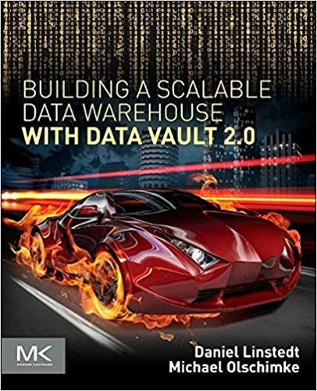
Data Vault 2.0
¿Qué es Data Vault?
Pilares Fundacionales
“A System of Busines lntelligence containing the necessary components needed to accomplish enterprise vision in Data Warehousing and lnformation Delivery”
Daniel Linstedt
Metodología
Consistente
Basada en patrones
Modelado
Flexible
Arquitectura
Replicable
Multi nivel
Escalable
Escalable
Metadato
Historia
A lo largo de 1999, 2000 y 2001, el diseño de Data Vault se probó, refinó e implementó en sitios de clientes específicos.
En 2002, se pidió a los líderes de opinión de la industria que revisaran la arquitectura.
In 2013 Dan Lindstedt introduced Data Vautl 2.0
Características
Diseño híbrido entre 3NF y Star Schema.
Gran enfoque en claves comerciales e identificación de las claves de negocio
Acceder a los datos como lo hace la empresa
Flexibilidad para adaptarse a grandes cambios
Agilidad para adaptarse a cambios rápidos
Auditoria y Gobernanza de dato

Slide 10
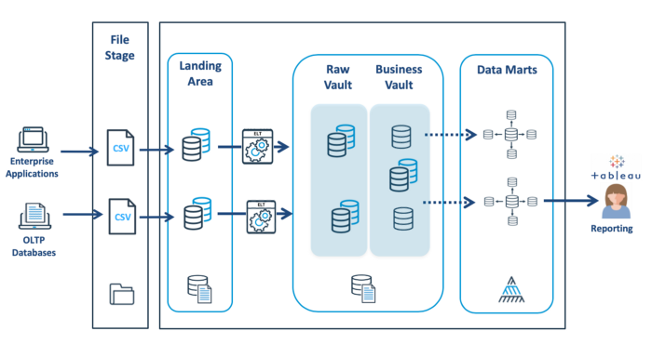
Data Vault 2.0
Stage
Data Vault
Information Layer
Fuente: John Ryan (2020) Data Vault — An Overview

Slide 11
Overview
1
Evolución de Data Warehousing
2
Data Vault 2.0
3
Modelado en Data Vault 2.0
4
Arquitectura de Data Vault 2.0
5
Conclusiones

Slide 12
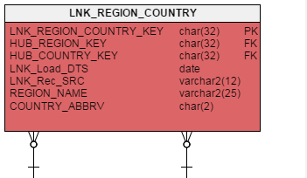
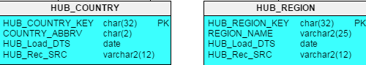
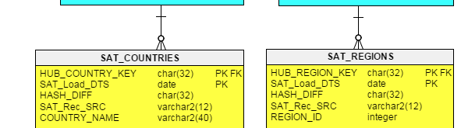
Modelado de Data Vault 2.0
Hub
Almacena BK
Componente central del modelo
Desacopla la gestión de claves de negocio de los atributos
Link
Une dos o más Hub entre sí
Representa transacciones: asociaciones y jerarquías.
Modelado como una relación M:N
Granularidad definida por el número de Hubs que une
Satellite
Almacena los atributos descriptivos de una relación comercial.
Agrega contexto a un Hub o Link
Realiza un seguimiento de los cambios en los datos

Slide 13
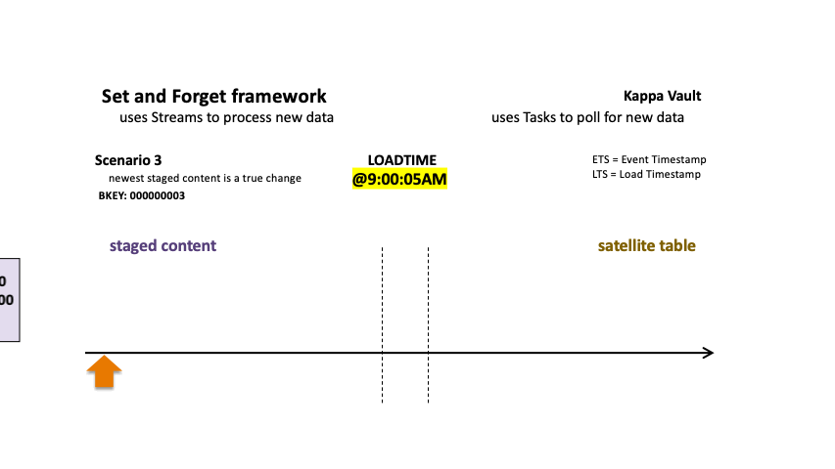
Modelado de Data Vault 2.0: Control histórico de cambios
Control histórico de cambios
en Satelites
DV permite obtener un registro con varias versiones de cada registro
Los nuevos datos son introducidos en función del valor de la columna HASDIFF
Funcionamiento similar a 2D Slow Changing Dimension
No permite responder a la pregunta: ¿Qué ocurrió cuándo?
Fuente: Patrick Cuba (2022) Data Vault on Snowflake: Streams & Tasks on Views

Slide 14
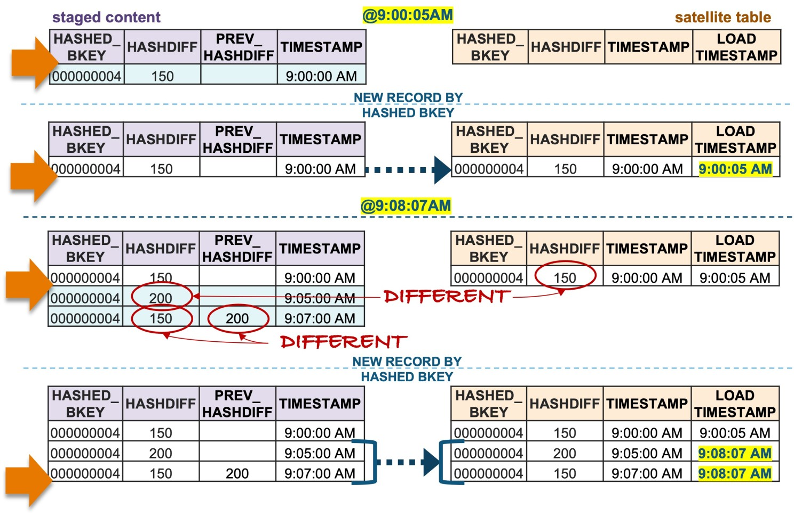
Modelado de Data Vault 2.0
Fuente: Patrick Cuba (2022) Data Vault on Snowflake: Streams & Tasks on Views

Slide 15
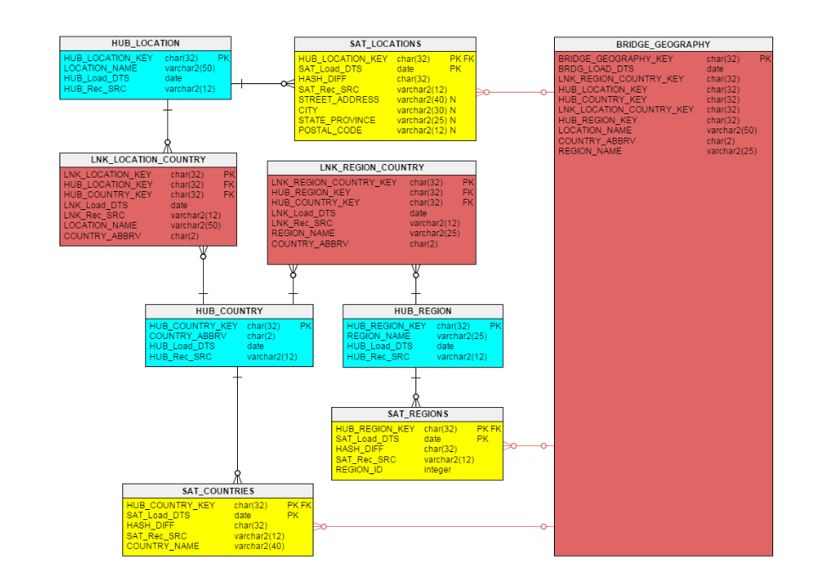
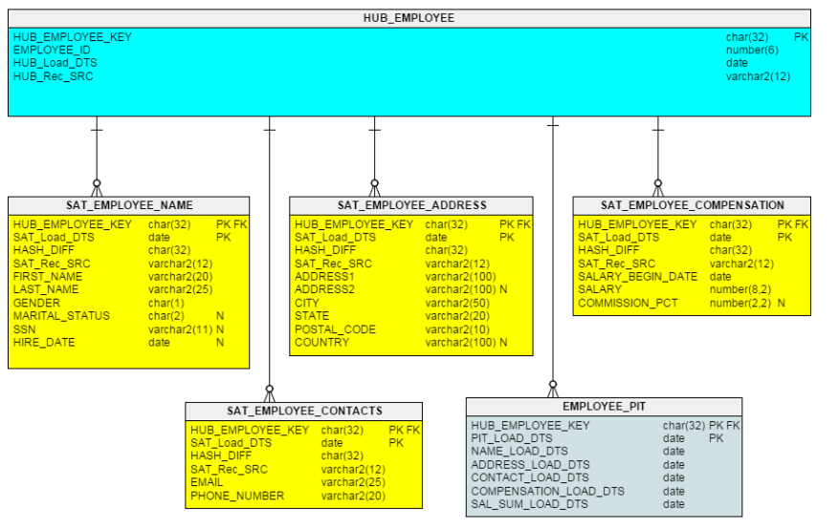
Modelado de Data Vault 2.0: Performance Tables
PIT (Point in time)
Une información de Sats
Facilita el acceso a los datos contenidos en los distintos Sats de un hub o link
Proporciona balizas temporales
Bridge
Contienen los hash keys de los Hub o Link.
Mejor desempeño de las consultas a base de datos reduciendo la cantidad de JOINS
Factless Fact table

Slide 16
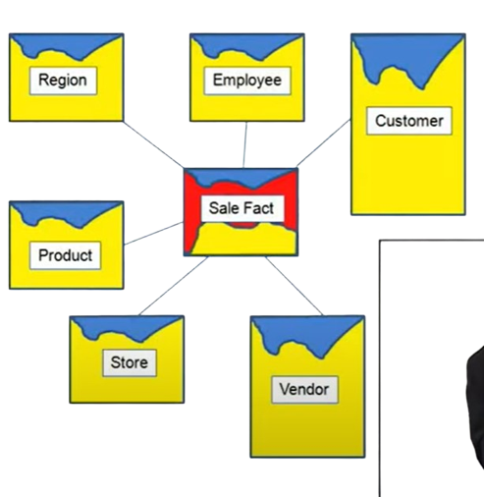
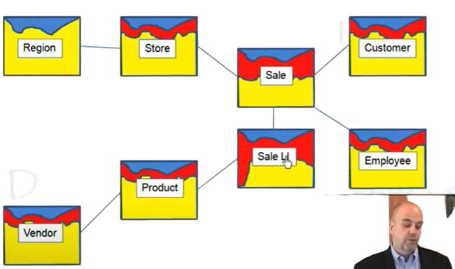
Diferencias entre Modelos de DW
3Normal Form
Star Schema
Data Vault Academy (2013) Colors of the Data Vault

Slide 17
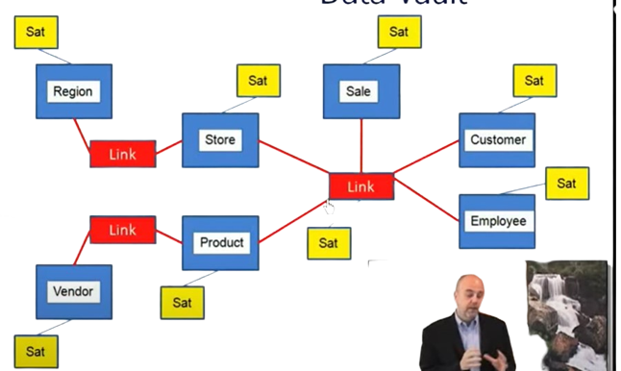
Modelado de Data Vault 2.0
Data Vault 2.0
Data Vault Academy (2013) Colors of the Data Vault

Slide 18
Overview
1
Evolución de Data Warehousing
2
Data Vault 2.0
3
Modelado en Data Vault 2.0
4
Arquitectura de Data Vault 2.0
5
Conclusiones

Slide 19
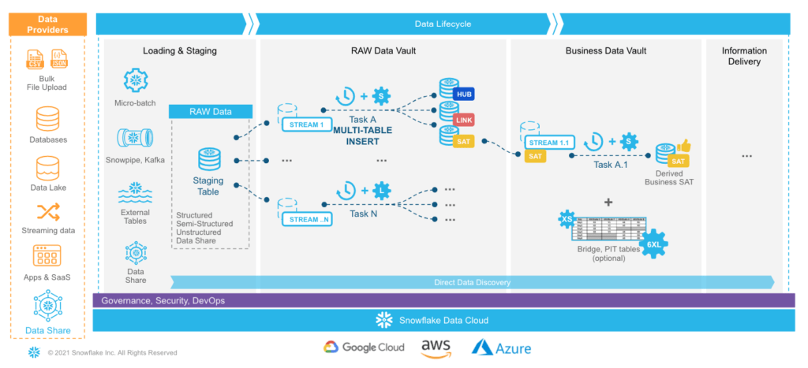
Arquitectura Data Vault 2.0: Snowflake
Building a Real-Time Data Vault in Snowflake (2013) Joyce Kay Avila

Slide 20
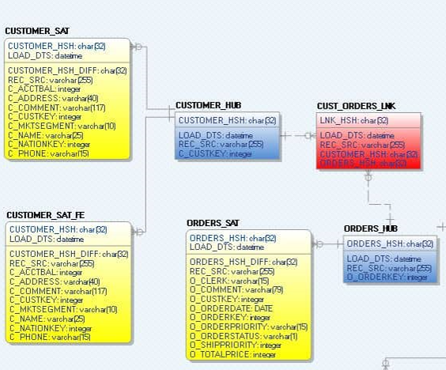
Arquitectura Data Vault 2.0: Snowflake
Building a Real-Time Data Vault in Snowflake (2013) Joyce Kay Avila

Slide 21
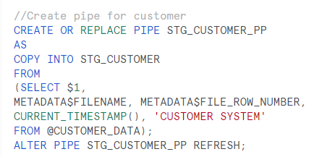
Stage Layer
Stage
Data Vault
Information Layer
Carga de tablas y metadatado
Se hace mediante Tablas Stage
Utilización de Streams de Snowflake
Las tablas no sufren transformación, únicamente se añaden:
Hash (Algoritmo: SHA1 BINARY,MD5)
MetaData
Para automatización: SNOWPIPE

Slide 22
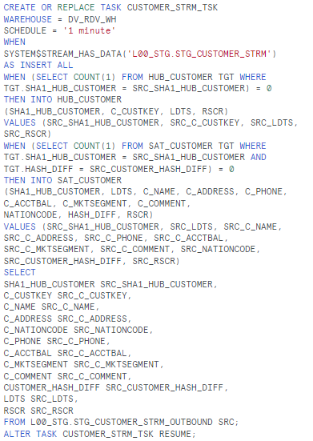
Data Vault Layer: Raw Data Vault
Stage
Data Vault
Information Layer
Creación de entidades
Se crean las tablas core de Data Vault 2.0
Hub
Link
Satélite
Se rellenan las tablas con los Streams
Para automatización: TASKS

Slide 23
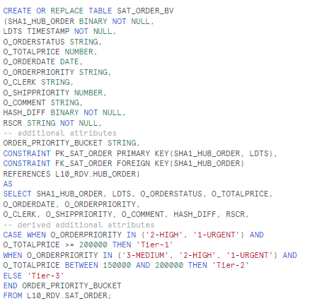
Data Vault Layer: Business Vault
Stage
Data Vault
Information Layer
Completamos la capa Data Vault
Creación nuevas tablas
Describe la realidad del negocio
Atributos derivados
Reglas de negocio
Bussiness Inteligence
Utilización de Permormance Tables para la optimización de los procesos
Para automatización: TASKS

Slide 24
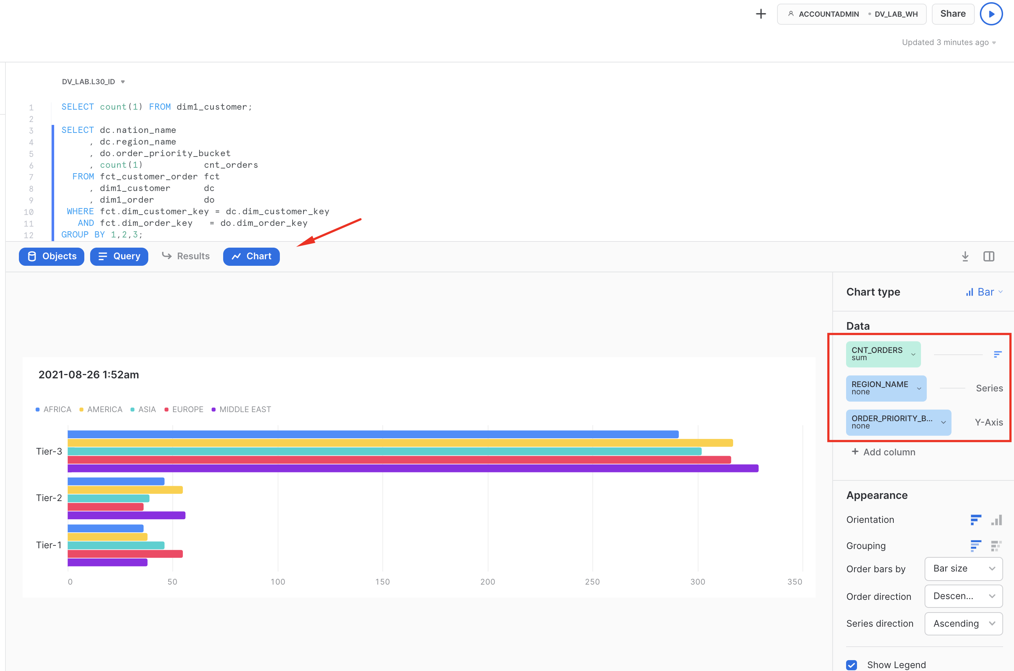
Information Layer:
Stage
Data Vault
Information Layer
Entrega al usuario de negocio
Generación de vistas para su consumo
Star Schema
Data Marts
Otros
Nos permiten servir los datos en un formato conocido por el usuario final
Consumo en herramientas de BI
Tableu
Power BI
Microstrategy

Slide 25
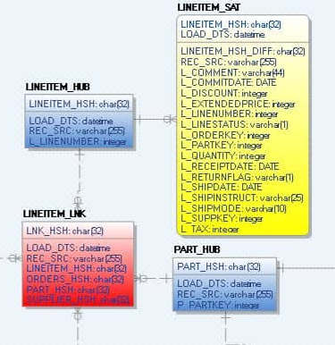
Práctica: Crecimiento del modelo Añadir las tablas referentes al concepto de negocio LINEITEM
Building a Real-Time Data Vault in Snowflake (2013) Joyce Kay Avila

Slide 26
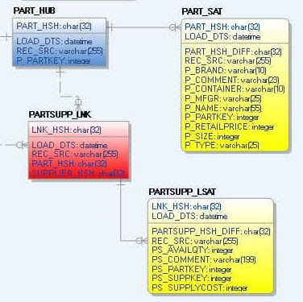
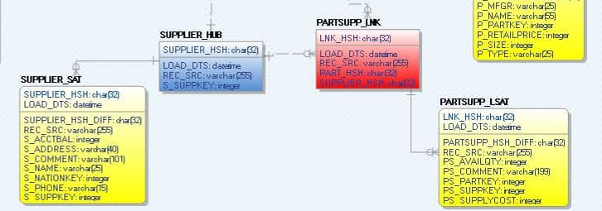
Práctica: Crecimiento del modelo Añadir las tablas referentes al concepto de negocio LINEITEM
Building a Real-Time Data Vault in Snowflake (2013) Joyce Kay Avila

Slide 27
Overview
1
Evolución de metodologías de Data Warehousing
2
¿Qué es Data Vault?
3
Modelado en Data Vault
4
Arquitectura de Data Vault en Snowfkale
5
Conclusiones

Slide 28
Conclusiones
Ventajas
Desventajas
Incremental delivery
Flexibility
Reduced Complexity
Raw Data Included
Supports change over time
Lineage (DG) and Audit
High-Performance Parallel Loads
Possible to Automate
Expertise in Data Vault and highlevel of engineering skill required
Large storage requirements
Many-To-Many relationships means more joins
Using a 3-Layer architecture with sublayers means more steps until data gets used for Bl

Slide 29
Conclusiones
¿Es Data Vault 2.0 para mí?
High ingestion throughput
Auditability is required
Integration of many source systems
(SQL, noSQL, New SQL)
Keep track of the full history of the data
Collaboration between many teams
Heterogeneous source data

Slide 30
Referencias
Fuente: John Ryan (2020) Data Vault — An Overview https://medium.com/snowflake/data-vault-an-overview-27bed8a1bf9f
Patrick Cuba (2022) Data Vault on Snowflake: Streams & Tasks on Views https://www.linkedin.com/pulse/data-vault-snowflake-streams-tasks-views-patrick-cuba/
Data Vault Academy (2013) Colors of the Data Vault https://www.youtube.com/watch?v=kRoDRlj8_YU
Snowflake NRT Real-Time Data Vault 2.0 Implementation (Step by Step Hands on Example with Code) (2022) Joyce Kay Avila https://www.youtube.com/watch?v=zb89rvl4_Xs
Data Vault - Everything you need to know - Unit8 Talks #24 (2022) Unit8 https://www.youtube.com/watch?v=x5P_chSvuFs&t=1909s
Understanding Data Vault 2.0 (2022) Dan Lindsted - DataVault Alliance https://www.youtube.com/watch?v=y7faBrUcb74&t=228s

Slide 31
Gracias

